Slide 1
Determining the part
Understanding multiplicative relationships: fractions and ratio

Slide 2
how to use Oak lessons

Slide 3
I can determine one part, given the other part and the ratio.

Slide 4
Variables are in proportion if they have a constant multiplicative relationship.
A ratio shows the relative sizes of 2 or more values and allows you to compare a part with another part in a whole.

Slide 5

Determining the part
Using a bar model to find one part
Using ratio tables to find one part

Slide 6
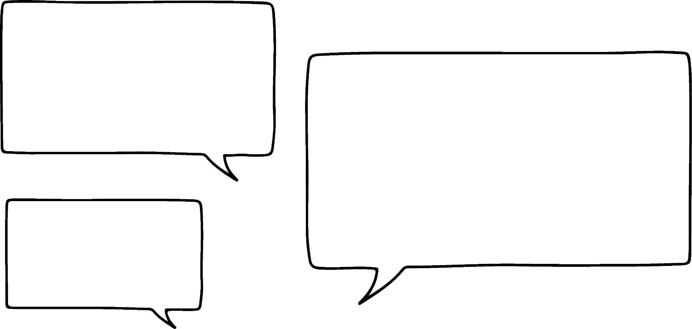
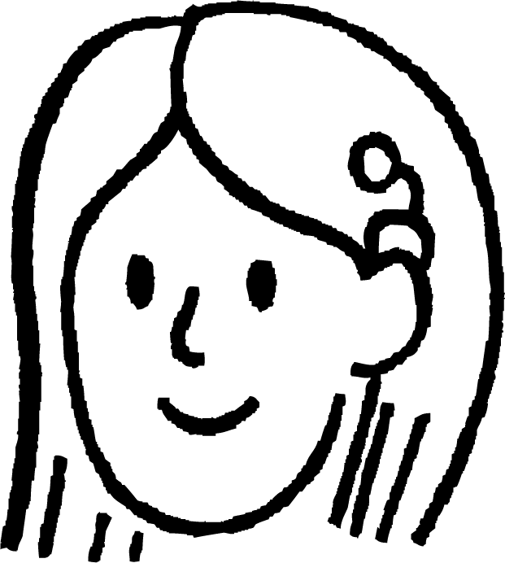
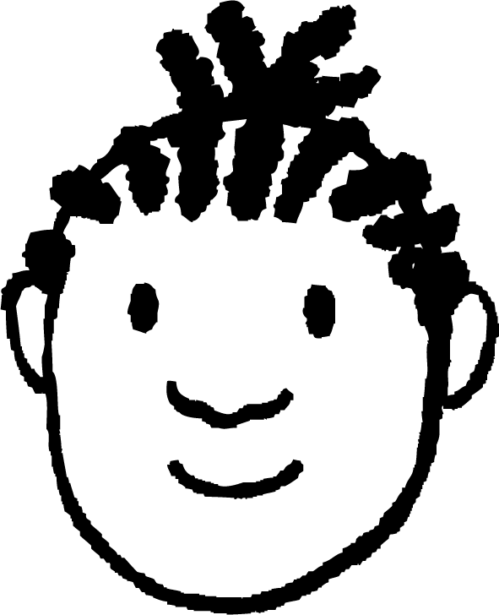
Using a bar model to find one part
Sofia is making some bracelets.
She will use white and black beads in the ratio 1 : 6
I am going to use 3 white beads.
How many black beads will be on each bracelet?
Sofia
Jacob
Let’s draw a bar model to represent this.
Each part of the bar model represents an equal part.
Do you need to find the total number of beads?
3
White
3
This means 3 needs to go in all parts.
No, Jacob only asked how many black beads there will be.
Each necklace will have a total of 18 black beads.
Black
3 | 3 | 3 | 3 | 3 | 3
6 × 3 = 18

Slide 7


Using a bar model to find one part
A bunch of flowers contains red and yellow flowers in the ratio 3 : 5
There are 6 red flowers.
How many yellow flowers are in the bunch?
6 ÷ 3 = 2
Red
2
2
2
Yellow
2
2
2
2
2
5 × 2 = 10

Slide 8
Using a bar model to find one part
The ratio of flour to butter to sugar in a cookie recipe is 3 : 2 : 1
You use 60g of flour.
How much butter is used?
60 g ÷ 3 = 20 g
Flour
20 g
20 g
20 g
Butter
20 g
20 g
2 × 20 g = 40 g
Sugar
20 g
The cookie will have 40 g of butter.

Slide 9


Using a bar model to find one part
Spot the mistake.
The ratio of red to blue cars in a car park is 5 : 2
There are 100 blue cars.
How many red cars are there?
100 ÷ 5 = 20
Red
20
20
20
20
20
7 × 20 = 140
Blue
20
20
100 has been put in the wrong place, it was the number of blue cars not the number of red cars. Also, they have found the total not the number of red cars.

Slide 10
Using a bar model to find one part
Here is another common mistake made with ratio problems.
Can you spot it?
The ratio of red to blue cars in a car park is 5 : 3
There are 120 red cars.
How many blue cars are there?
120 is not the total number of cars.
Always using the given number as the total is a common mistake. Drawing and labelling a bar model correctly can help you to check you are working out the correct part.
Here is Sofia’s work:
5 + 3 = 8
120 ÷ 8 = 15
Red : blue = 5 : 3
Blue = 3 × 15 = 45 blue cars

Slide 11
Using a bar model to find one part
Lucas and Aisha share a packet of sweets in the ratio 7 : 5
Aisha has 25 sweets.
How many sweets does Lucas have?
Lucas and Aisha share a packet of sweets in the ratio 4 : 7
Lucas has 16 sweets.
How many sweets does Aisha have?
7 × 5 = 35
16 ÷ 4 = 4
Lucas
5 | 5 | 5 | 5 | 5 | 5 | 5
4 | 4 | 4 | 4
Lucas
Aisha
5 | 5 | 5 | 5 | 5
4 | 4 | 4 | 4 | 4 | 4 | 4
Aisha
25 ÷ 5 = 5
7 × 4 = 28
Lucas has 35 sweets.
Aisha has 28 sweets.

Slide 12
Using a bar model to find one part
Use a bar model to find either A or B given the ratio:
Ratio A : B | A | B
1 : 3 | 6
2 : 1 | 18
3 : 8 |  | 32
4 : 5 |  | 65
2 : 5 |  | 30
7 : 3 | 84
2 : 9 | 96
4 : 7 |  | 175

Slide 13
Using a bar model to find one part
2) Use a bar model to answer the following:
Andeep, Sam and Sofia share some sweets in the ratio 3 : 8 : 5 Sofia gets 15 sweets, how many do Andeep and Sam get?
The lengths of the sides of a triangle are in the ratio of 7 : 6 : 4 The shortest length is 12 cm, what are the lengths of the other 2 sides?
The ratio of flour to butter to sugar in a cookie recipe is 3 : 2 : 1 You use 450 grams of flour, how much butter and sugar do you need?

Slide 14
Using a bar model to find one part
Use a bar model to find either A or B given the ratio:
Ratio A : B | A | B
1 : 3 | 6 | 18
2 : 1 | 18 | 9
3 : 8 | 12 | 32
4 : 5 | 52 | 65
2 : 5 | 12 | 30
7 : 3 | 84 | 36
2 : 9 | 96 | 432
4 : 7 | 100 | 175

Slide 15
Using a bar model to find one part
2) Use a bar model to answer the following:
Andeep, Sam and Sofia share some sweets in the ratio 3 : 8 : 5 Sofia gets 15 sweets, how many do Andeep and Sam get? Andeep = 9 and Sam = 24
The lengths of the sides of a triangle are in the ratio of 7 : 6 : 4 The shortest length is 12 cm, what are the lengths of the other 2 sides? 21 cm and 18 cm
The ratio of flour to butter to sugar in a cookie recipe is 3 : 2 : 1 You use 450 grams of flour, how much butter and sugar do you need? Butter = 300 g and sugar = 150 g

Slide 16
Determining the part
Using a bar model to find one part
Using ratio tables to find one part

Slide 17
Using ratio tables to find one part
The ratio of orange juice to lemonade in a drink is 3 : 7
Sofia wants to make a jug of the drink.
She has 600 ml of orange juice.
How much lemonade does she need?
Orange juice | Lemonade
3 | 7
600 | 1400
Total
10
What is the multiplicative relationship between these?
× 200
Sofia needs 1400 ml of lemonade.

Slide 18
Using ratio tables to find one part
Lucas and Aisha raise some money doing a sponsored silence.
They split the money between 2 charities in the ratio 4 : 5
Charity A gets £80.
How much money did charity B get?
Charity A | Charity B
4 | 5
£80 | 100
Total
9
What is the multiplicative relationship between these?
× 20
Charity B got £100.

Slide 19
Using ratio tables to find one part
Sofia is making some different bracelets with red, blue and white beads in the ratio 2 : 7 : 5
She uses 14 blue beads.
How many red and white beads does she use?
Red | Blue | White
2 | 7 | 5
4 | 14 | 10
Total
14
× 2
Each necklace will have 4 red beads and 10 white beads.

Slide 20
Using ratio tables to find one part
The ratio of red : blue : black cars in a car park is 8 : 5 : 12
There are 48 black cars.
How many red and blue cars are in the car park?
The ratio of red : blue : black cars in a car park is 8 : 5 : 12
There are 35 blue cars.
How many red and black cars are in the car park?
Red | Blue | Black
8 | 5 | 12
32 | 20 | 48
Total
25
Red | Blue | Black
8 | 5 | 12
56 | 35 | 84
Total
25
× 4
× 7
There are 32 red and 20 blue cars in the car park.
There are 56 red and 84 black cars in the car park.

Slide 21
Using ratio tables to find one part
Use a ratio table to find either A or B given the ratio:
Ratio A : B | A | B
1 : 3 | 9
2 : 1 | 36
3 : 8 |  | 128
4 : 5 |  | 225
2 : 5 |  | 1500
7 : 3 | 84
2 : 9 | 845
4 : 7 |  | 47.6

Slide 22
Using ratio tables to find one part
2) Use a ratio table to answer the following:
Andeep, Sam and Sofia share some sweets in the ratio 3 : 8 : 5. Sam gets 40, how many sweets do Andeep and Sofia get?
The lengths of the sides of a triangle are in the ratio of 7 : 6 : 4. The longest length is 14 cm, how long are the other sides?
The ratio of flour to butter to sugar in a cookie recipe is 3 : 2 : 1. You use 126 grams butter, how much flour and sugar do you need?

Slide 23
Using ratio tables to find one part
Use a ratio table to find either A or B given the ratio:
Ratio A : B | A | B
1 : 3 | 9 | 27
2 : 1 | 36 | 18
3 : 8 | 48 | 128
4 : 5 | 180 | 225
2 : 5 | 600 | 1500
7 : 3 | 84 | 36
2 : 9 | 845 | 3802.5
4 : 7 | 27.2 | 47.6

Slide 24
Using ratio tables to find one part
2) Use a ratio table to answer the following:
Andeep, Sam and Sofia share some sweets in the ratio 3 : 8 : 5. Sam gets 40, how many sweets do Andeep and Sofia get? Andeep = 15 and Sofia = 25
The lengths of the sides of a triangle are in the ratio of 7 : 6 : 4. The longest length is 14 cm, how long are the other sides? 12 cm and 8 cm
The ratio of flour to butter to sugar in a cookie recipe is 3 : 2 : 1. You use 126 grams butter, how much flour and sugar do you need? Flour = 189 g and sugar = 63 g

Slide 25
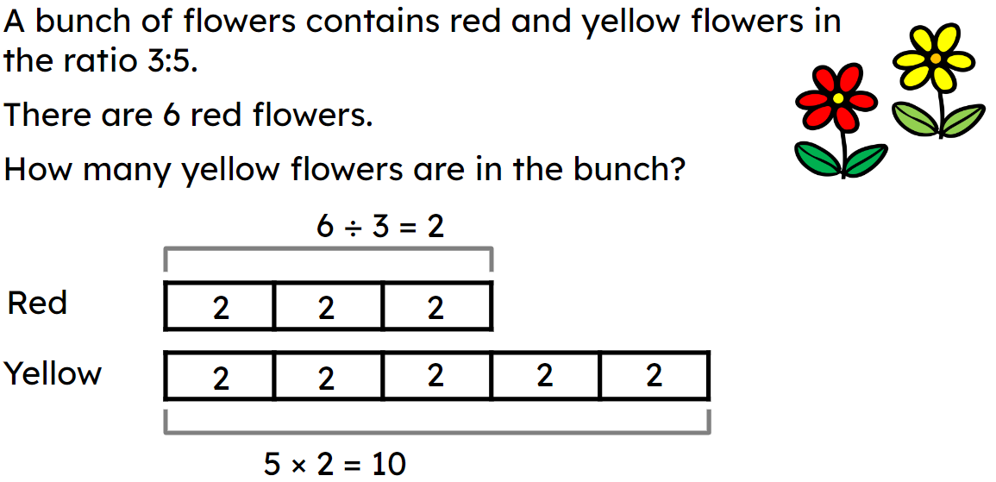
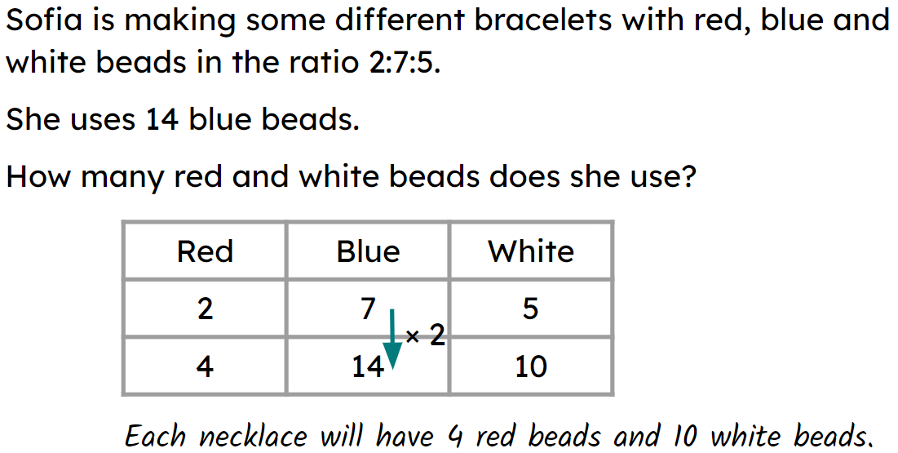
Determining the part
A bar model can be used to determine the part.
E.g.
A more efficient way to determine the part is to use a ratio table.
E.g.

Slide 26

© Oak National Academy 2023.
Produced in partnership with Mathematics in Education and Industry.
Licensed on the Open Government Licence v3.0, except where otherwise stated. See Oak terms and conditions.

